Slide 1
How Life Support Systems are connected to each other
Matthew Katterman

Slide 2
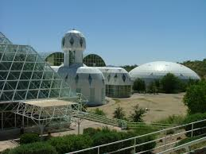
Biosphere 2 – Self Contained Ecosystems
What if we wanted to live on Mars, how could we live there?
Creating self-contained Ecosystems within domed environments.
Ecosystem – a community or group of living organisms that live and interact with each other in a specific environment.
Biosphere 2 created several Ecosystem Environments (at least seven).

Slide 3
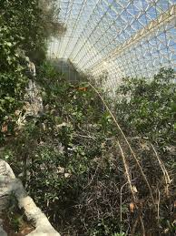
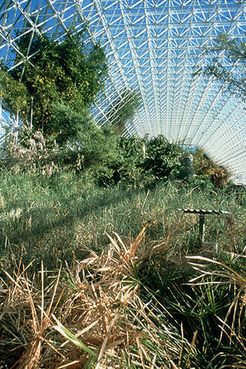
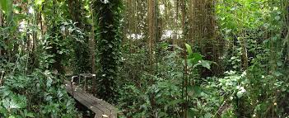
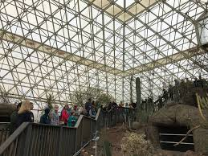
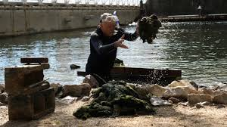
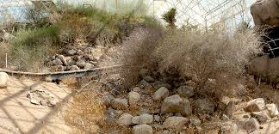
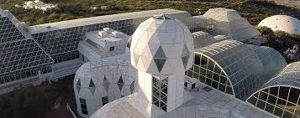
Biosphere 2 Ecosystems
Forested Swamps
Savannah Grassland
Tropical Rainforest
Coastal Fog Desert
2600 m² Ocean
Desert Shrubland
Model City

Slide 4
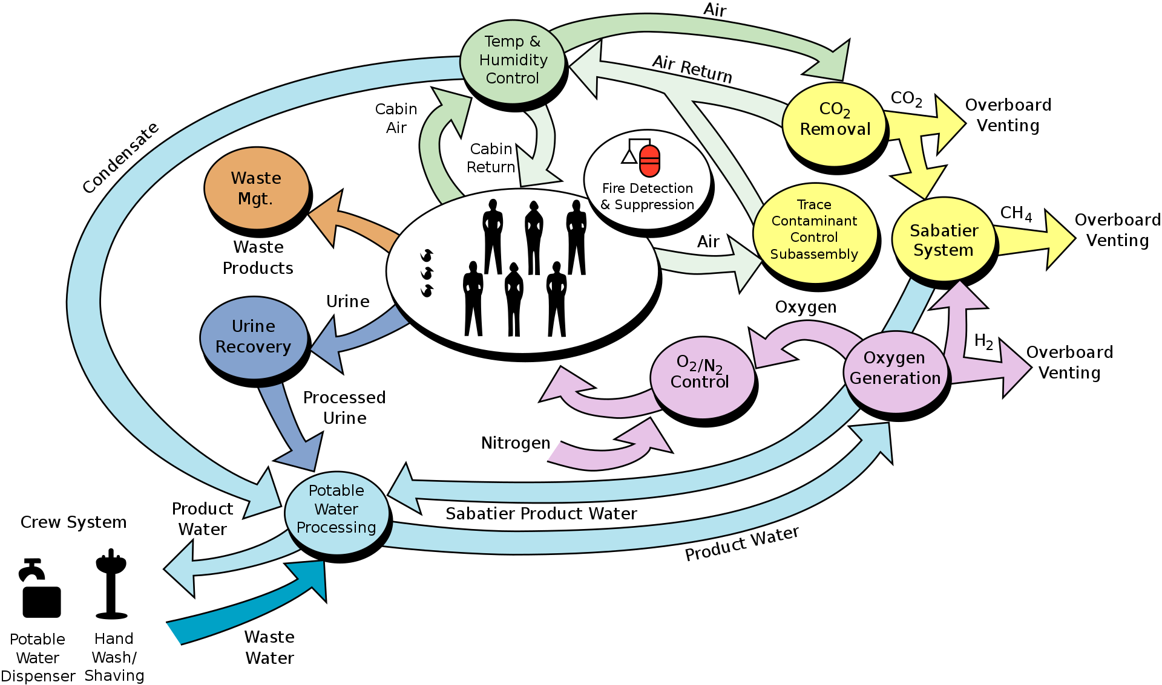
Life Support Systems working together

Slide 5
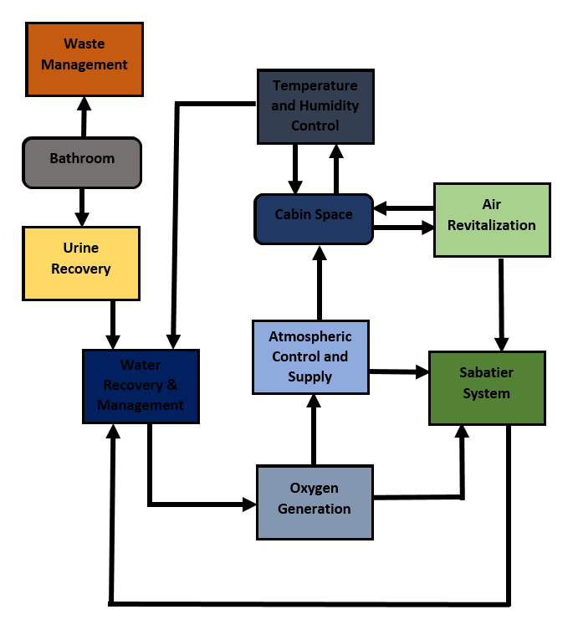
Life Support Systems Flow Chart

Slide 6
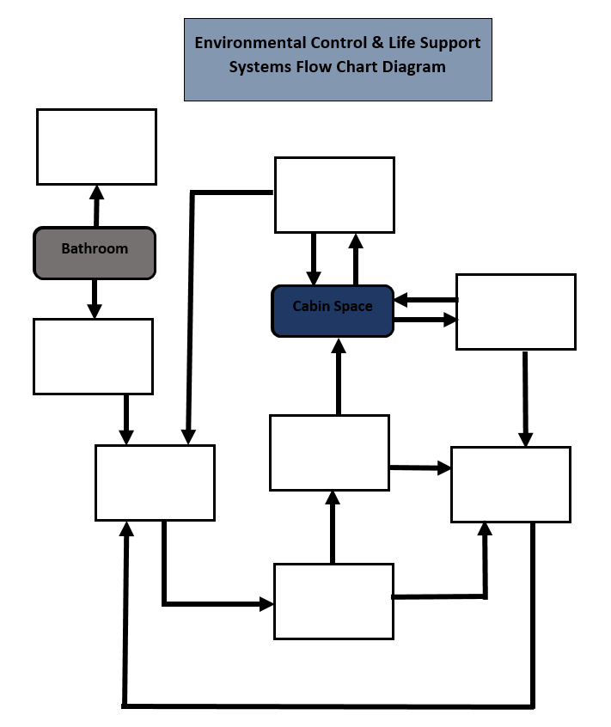
Drawing Activity

Slide 7
Completed Drawing Activity

Slide 8
Humidity & Temperature working with both Air and Water Systems
Humidity and Temperature Control
Water Recovery & Management
Air Revitalization

Slide 9
Air & Water Systems Working Together
Atmospheric Control and Supply
Air Revitalization
Oxygen Generation
Sabatier System
Water Recovery & Management

Slide 10
Life Support Self Sustaining System
Water
Oxygen Generation System
Oxygen
Hydrogen
Methane (Electricity)
Sabatier System
Carbon Dioxide
Atmospheric Control & Supply System

